Slide 1
Identifying school climate variables associated with financial literacy outcomes in PISA 2018 data
A multilevel structural equation modelling approach

Slide 2
Motivation
If you think education is expensive, try ignorance.
— Derek Bok

Slide 3
Objectives
Literature gaps
Disconnect between learners and their school environment
Inconclusive effectiveness
Research questions
To what extent can the variation in students’ financial literacy outcomes be accounted for by each of the school climate variables?
How does the school-level climate impact on individual learners’ financial literacy acquisition process?

Slide 4
Framework
School Climate
(Input, X)
Academic
F Learning
(Process, M)
F familiarity
F Literacy
(Output, Y)
Community
Safety
Inst Env
F confidence
F problem-solving

Slide 5
Sample
PISA 2018: 20 countries, 6,631 schools, 107,162 students

Slide 6
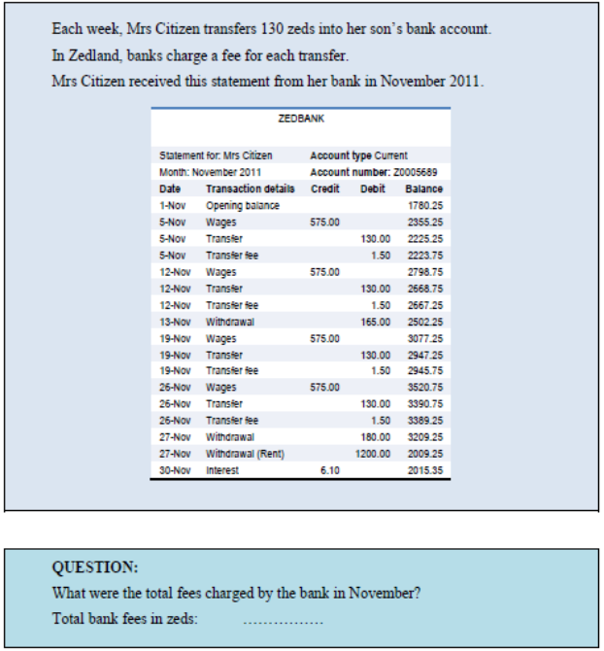
Measures
Construct | Variable | Procedure | Reliability
Academic | FLSCHOOL | IRT scaling: PCM | .846—.926
Community | FLFAMILY | IRT scaling: PCM | .792—.871
Safety | NOBULLY | IRT scaling: PCM | .638—.892
Inst env | EDUSHORT | IRT scaling: PCM | .752—.892
F familiarity | FCFMLRTY | sum score
F confidence | FLCONFIN | IRT scaling: PCM | .872—.939
F literacy | FLIT | 10 PVs

Slide 7
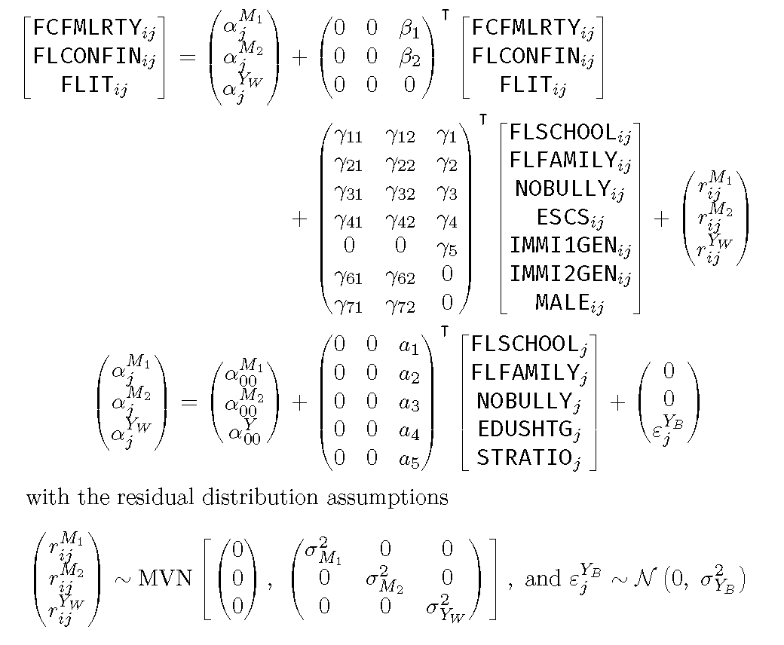
Multilevel Structural Equation Modelling

Slide 8
Results
Model fit indices | Estimate | Cut-off
RMSEA | .009 | <.06
CFI | .968 | >.95
SRMR L1 | .015 | <.08
SRMR L2 | .030 | <.08
 | F Education | F Socialisation | Safety
Contextual effect | –0.163*** | –0.144*** | 0.144***
Effect size | –0.378*** | –0.332*** | 0.331***

Slide 9
Discussion
Research questions:
1: school climate ‹—› F literacy
2: school-level —› student-level
Negative pathways?
Country differences?
Contributions
person-ecological approach
doubly-latent model
 |  | Model | 246 FIN |  |  | 840 USA
 |  | parameter | Coef | SE |  | Coef | SE
FIXED EFFECTS
 | Intercept |  | 470.013 | 68.296 | *** | 493.961 | 19.147 | ***
Student-level Predictors
 | FLSCHOOL (total) | γ₁+γ₁₁β₁+γ₁₂β₂ | 0.169 | 0.021 | *** | –0.069 | 0.019 | ***
 | --direct | γ₁ | 0.080 | 0.020 | *** | –0.126 | 0.019 | ***
 | --total indirect | γ₁₁β₁+γ₁₂β₂ | 0.090 | 0.008 | *** | 0.057 | 0.007 | ***
 | --via FCFMLRTY | γ₁₁β₁ | 0.085 | 0.008 | *** | 0.056 | 0.006 | ***
 | --via FLCONFIN | γ₁₂β₂ | 0.004 | 0.003 | † | 0.001 | 0.003
 | FLFAMILY (total) | γ₂+γ₂₁β₁+γ₂₂β₂ | –0.067 | 0.017 | *** | –0.017 | 0.019
 | --direct | γ₂ | –0.083 | 0.017 | *** | –0.031 | 0.019
 | --total indirect | γ₂₁β₁+γ₂₂β₂ | 0.015 | 0.006 | ** | 0.014 | 0.005 | **
 | --via FCFMLRTY | γ₂₁β₁ | 0.011 | 0.005 | * | 0.013 | 0.004 | **
 | --via FLCONFIN | γ₂₂β₂ | 0.004 | 0.003 |  | 0.001 | 0.004
 | NOBULLY (total) | γ₃+γ₃₁β₁+γ₃₂β₂ | 0.027 | 0.018 |  | 0.065 | 0.019 | **
 | --direct | γ₃ | 0.019 | 0.018 |  | 0.060 | 0.019 | **
 | --total indirect | γ₃₁β₁+γ₃₂β₂ | 0.008 | 0.005 |  | 0.006 | 0.004
 | --via FCFMLRTY | γ₃₁β₁ | 0.007 | 0.005 |  | 0.006 | 0.004
 | --via FLCONFIN | γ₃₂β₂ | 0.001 | 0.001 |  | 0.000 | 0.001

